Slide 1
CHAPTER-1 Multimedia System
Prepared by: Er.Ramesh Basaula

Slide 2
Contents
Multimedia System
1.1 Introduction concept and structure
1.2 media aspect properties
1.3 Definition of multimedia system
1.4 Media combination and independence
1.5 Traditional data stream characteristics introduction units

Slide 3
1.1 Introduction concept and structure
Multimedia:
multimedia= multi + media
Multi means: - many, much, multiple
Medium means:
An intervening substance through which something is transmitted or carried on. A means of mass communication such as news paper, Television and so on.
It is means of presenting information. E.g. text, image, audio, etc.
Multimedia is woven combination of text, graphics, art, sound, animation, video and other kinds of elements.
It is a representation of information in an attractive and interactive manner with the use of a combination of medias such as text, audio, video, graphics and animation.
For examples: E-Mail, Messenger, Video Conferencing, and Multimedia Message Service , etc.

Slide 4
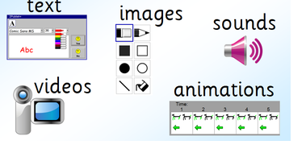
Components/Elements of Multimedia
Graphics/

Slide 5
Media/Medium
Media is plural form of medium.
Media is the means for distribution and presentation of information.
Example: text, graphics, audio, animation, etc.
In general, medium is an intervening substance through which some thing is transmitted or carried on.
We can classify media according to :
Perception
Representation
Presentation
Storage
Transmission
Information Exchange

Slide 6
i. Perception Media
Perception media help humans to sense their environment.
The perception of information occurs mostly through seeing or hearing the information.
There is a primary difference between seeing or hearing information when using a computer.
For the perception of information through seeing, the visual media such as text, image and video are used.
For the perception of information through hearing, auditory media such as music, noise and speech are relevant.

Slide 7
ii. Representation Media
Representation media are characterized by internal computer representation of information.
Various formats are used to represent media information in a computer.
The central question is: “How is computer information coded?”
Examples:
A text is character is coded in ASCII or EBCDIC code.
Graphics are coded according to CEPT or CAPTAIN video text standard.
An audio stream can be represented using a sample PCM (Pulse Code Modulation).
An image can be coded as a PNG or in JPEG format.
A combination of audio/video sequence can be coded in different standard formats. (Example, PAL, SECAM, NTSC) and stored in the computer using MPEG format.

Slide 8
iii. Presentation Media
It refer to the tools and devices for the input and output information.
The central question is: “Through which medium is information delivered by the computer, or introduced into the computer?”
Examples:
Output devices/media: paper, printer and screen, etc.
Input media device/media: keyboard, mouse, camera and microphone, etc.

Slide 9
iv. Storage Media
It refers to a data carrier, which enables storage of information. However, the storage of data is not limited only to the available components of a computer.
The central question is: Where will the information be stored?
Microfilms, floppy disk, hard disk, pen drive, CD-ROM, DVD, zip disk are examples of storage media.

Slide 10
v. Transmission Media
The transmission medium characterizes different information carries that enable continuous data transmission.
The central question is: Over what will the information be transmitted?
Information is transmitted over network in two ways:
Wired: coaxial cable, fiber optic
Wireless: satellite, microwave, Radio link and so on.

Slide 11
vi. Information Exchange
It includes all information carrier for transmission i.e. all storage and transmission media.
The central question is: “Which information carrier will be used for information exchange between different places?”

Slide 12
Representation values and Representation space:
Each medium defines the following:
1- Representation Values
Representation values means which information is actually being presented.
what is being shows?
Example are: text, music, video, image, etc.
It can be considered as a continuous or a sequence of discrete values.
2- Representation Space
Representation space refers to the area of the medium which is used to present the information.
Where is it being show?
E.g. paper or computer monitors are examples of a visual presentation spaces.

Slide 13
Representation Dimensions
Media can be divided into two types with respect to time in their representation space:
1. Time-independent (discrete)
These media are independent of time.
Examples: text , pictures and graphics, etc.
Information in these media consist exclusively of a sequence of individual elements without a time component.
2. Time-dependent (continuous)
These media are dependent on time.
Examples: sound and video, etc.
Information is expressed not only on the individual value but also the time of its occurrence (requires a continuous play out as a time passes).

Slide 14
Representation dimensions of a representation space are:
Spatial dimensions:
Related to the space.
two dimensional (2D graphics)
three dimensional (holography)
Temporal dimensions:
Related to the time.
Time independent (document) - Discrete media
Information consists of a sequence of individual elements without a time component.
Time dependent (movie) - Continuous media
Information is expressed not only by its individual value but also by its time of occurrence.

Slide 15
Definition of multimedia system
A multimedia system is any system, which supports more than a single kind of media.
Multimedia System is characterized by the processing, storage, generation, manipulation and presentation of multimedia information
Examples: Video on demand, Electronic book, Interactive cinema, Internet Bookshop, and Games, etc.
The main properties are: (Characteristics of multimedia system)
Combination of media
Media-Independent
Computer Control and Integration
Communication Systems

Slide 16
1. Combination of media:
A multimedia system combines both continuous and discrete media.
A simple text processing program with incorporated images is often called a multimedia application because two media are processed through one program.
2. Media-Independent
An important aspect of different media is their level of independence from each other. In general, there is a request for independence of different media, but multimedia may require several levels of independence.
One the one hand, a computer controlled video recorder stores audio and video information, but there is an inherently tight connection between the two types of media.
One the other hand, for the purpose of presentations, the combination of DAT (Digital Audio Tape) recorder signals and computer available text satisfies the request for media-independent.

Slide 17
3. Computer Control and Integration
The media-independence prerequisite provides the possibility of combining media in arbitrary forms. Computers are ideal tool for this purpose.
The system should be capable of computer-controlled media processing. An integrated multimedia system is necessary to provide functionality that support all the different forms of media.
4. Communication system
Communication has become essential in multimedia systems.
Today's computers are interconnected and the multimedia functions should be available beyond the processing of a single computer.

Slide 18
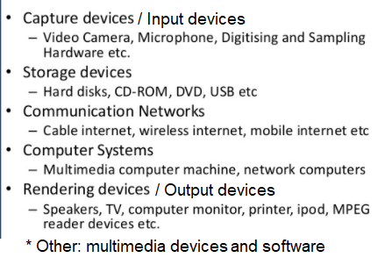
Components of Multimedia System

Slide 19
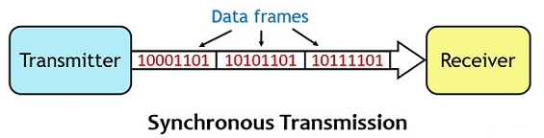
Data Stream Characteristics:
Transmission of information carrying different media leads to data stream with very different features, which are 3-modes of data transmission:
Synchronous Transmission Mode:
The data is sent in blocks (called frames or packets) spaced by fixed time intervals
The synchronous transmission mode defines a maximum end-to-end delay for each packet of a data stream.
This upper bound will never be violated. Moreover, a packet can reach the receiver at any arbitrary earlier time (fast). Thus, an important claim of multimedia application is satisfied: a maximum end-to-end delay can be guaranteed.

Slide 20
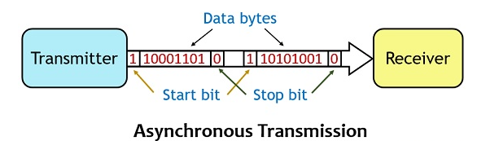
2. Asynchronous Transmission Mode:
The asynchronous transmission mode provides for communication with no timely restrictions. Packets reach the receiver as fast as possible.
All information of discrete media can transmitted as an asynchronous data stream.
If an asynchronous mode is chosen for transmission of continuous media, additional techniques must be applied to provide the time restrictions.
It must insert a start bit before each data character and a stop bit at its termination to inform the receiver where it begins and ends.

Slide 21
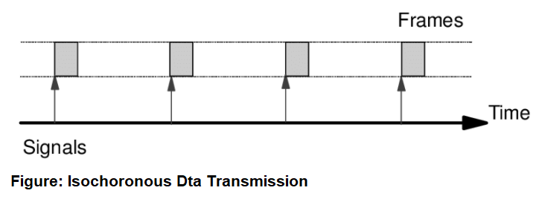
3. Isochronous Transmission Mode:
This isochronous transmission mode defines a minimum end-to-end delay for each packet of a data stream.
This means that the delay jitter of individual packets is bounded.
Jitter: the time delay between when a signal is transmitted and when it is received.
Each character or byte is framed as a separate and independent unit of DATA that may be transmitted and received at irregular and independent time intervals.

Slide 22
Data Stream characteristics for continuous Media:
Data stream for continuous media are categorized on the basis of following:
On the basis of time interval
Strongly periodic
Weakly periodic
A periodic
On the basis of variation of the amount of consecutive packets.
Strongly regular
Weakly regular
Irregular
On the basis of continuity or the connection between consecutive packets
Continuous stream
Discrete stream

Slide 23
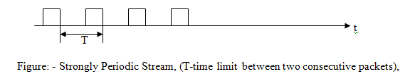
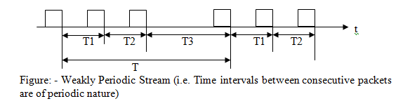
On the basis of time interval
Strongly periodic
If the time Interval between two consecutive packets is constant, a data stream is called strongly periodic.
Weakly periodic
If the time interval between two consecutive packets is not constant, then a data stream is called Weakly Periodic.

Slide 24
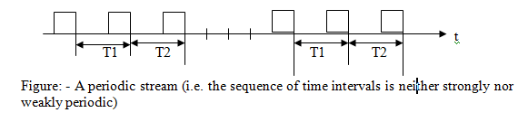
iii. A periodic data stream
All other possibilities of transmission with respect to time interval are known as a periodic data streams.
2. On the basis of variation of the amount of consecutive packets
Strongly regular
Weakly regular
Irregular

Slide 25
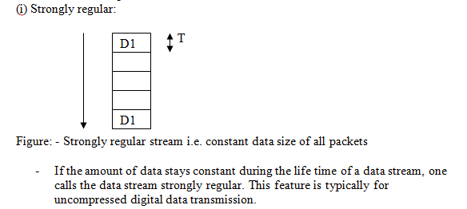
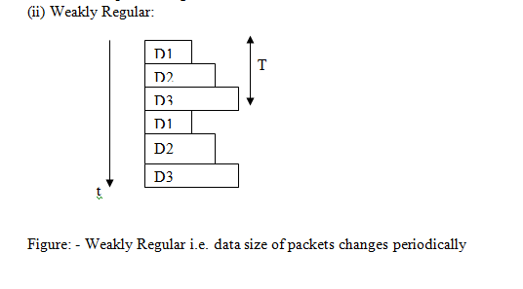
An example of a weakly regular data stream is a compressed video stream.

Slide 26
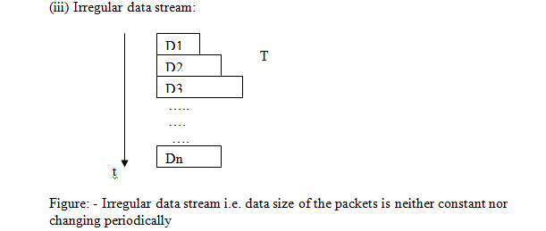

Slide 27
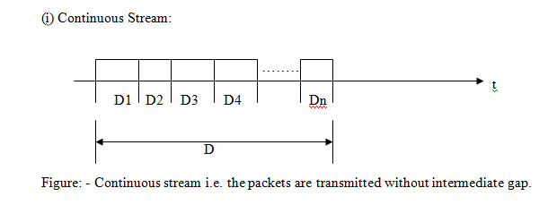
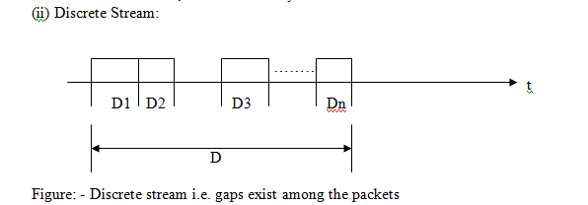
On the basis of continuity or the connection between consecutive packets

Slide 28
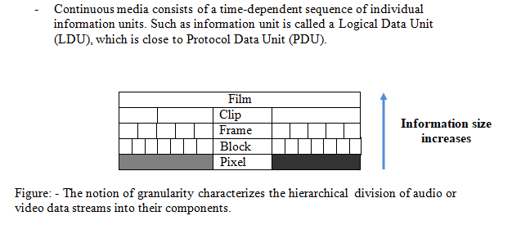
Information Units
Protocol data unit (PDU) is a single unit of information transmitted among peer entities of a computer network.

Slide 29
Applications of multimedia
Education
Medical
Entertainment industry (movie, game)
Business
Advertisement
Electronic messaging
Training
Scientific research and mathematics (multimedia is mainly used for modeling and simulation)
and so on.

